Slide 2
Ecommerce Signup Page
Feb 12, 2024
By: Shanmuk Kumar

Slide 3
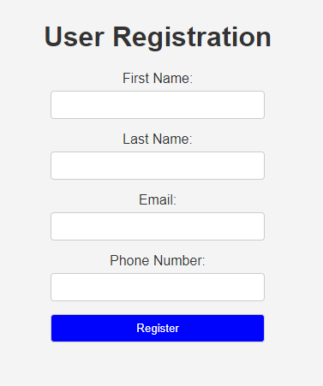
Agenda
SDLC
Objective
Problem Statement
Implementation
Logic
Input & output
Test Cases
JIRA

Slide 4
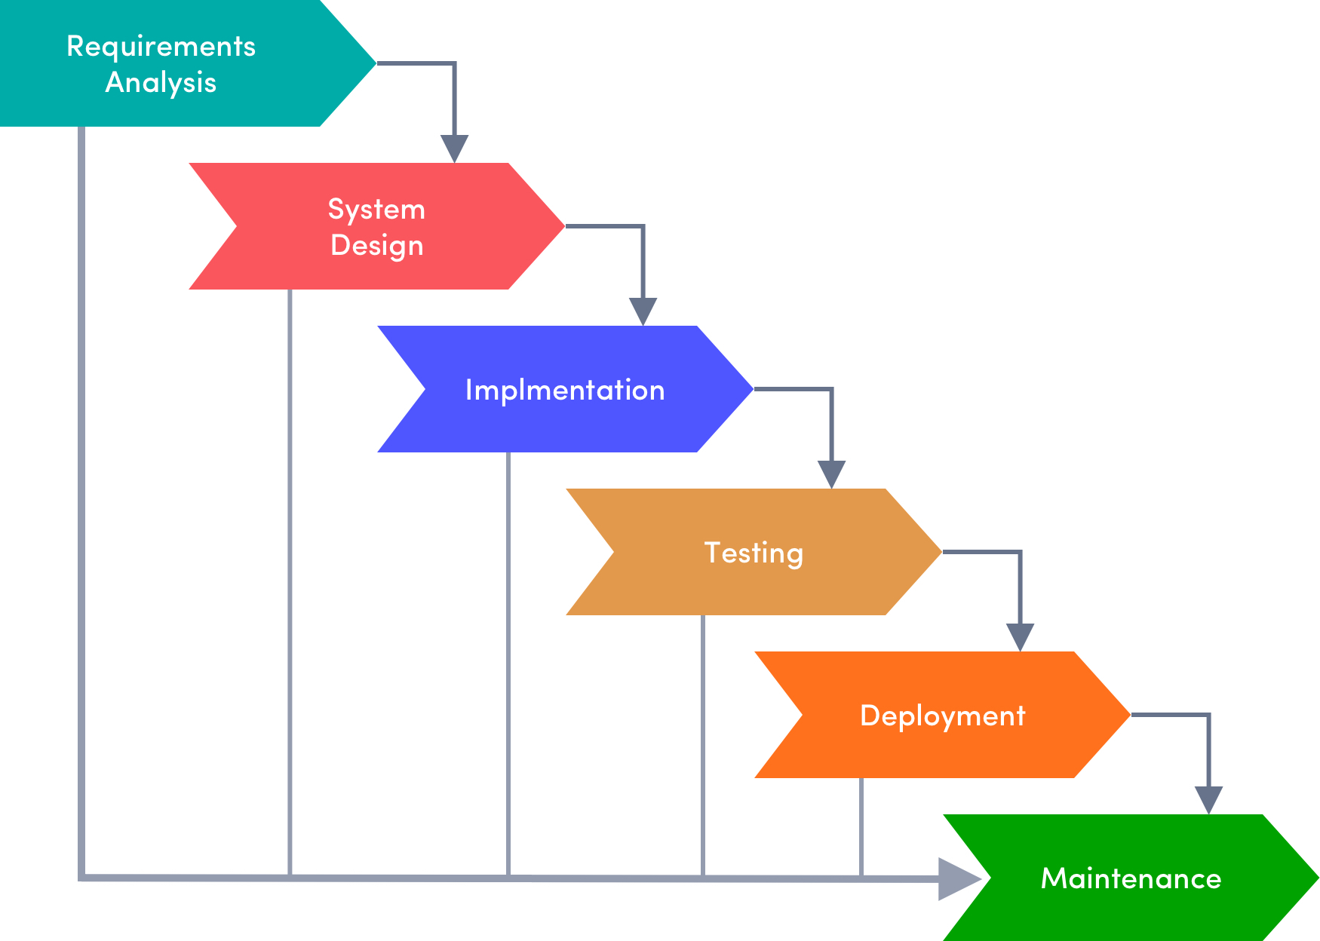
Software Development Lifecycle
The software development lifecycle (SDLC) is the cost-effective and time-efficient process that development teams use to design and build high-quality software.

Slide 5
Objective
The primary aim of this project is to create a console-based application for Ecommerce Signup Page. It enables users to create account in Ecommerce page. We take input as first name, last name, email id and mobile number for registration in Ecommerce page . This application then displays all the details which were entered by user and shows the registration is successful.

Slide 6
Implementing in JAVA
Implementing in NodeJS
FLOW CHART
Connecting to Database
Displaying in Browser
Testing

Slide 7
Problem Statement
Design a simple console-based program for an Ecommerce Signup Page. The program should allow users to create account in ecommerce. We have to get information like First Name, Last Name, Email Address, Phone Number.

Slide 8
Implementation using Java
Class & Object
Exception handling
Encapsulation
Packages
Validations

Slide 9
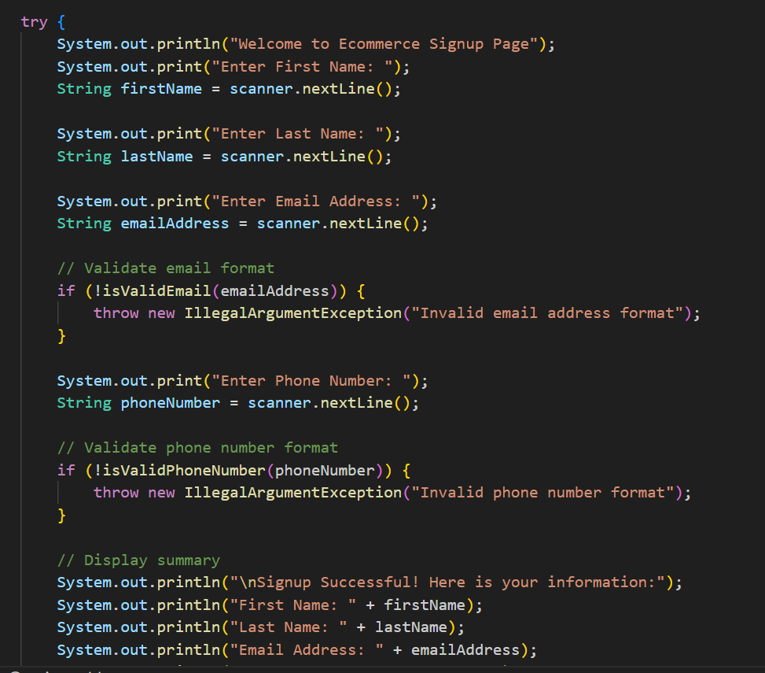
Logic
Validations:

Slide 10
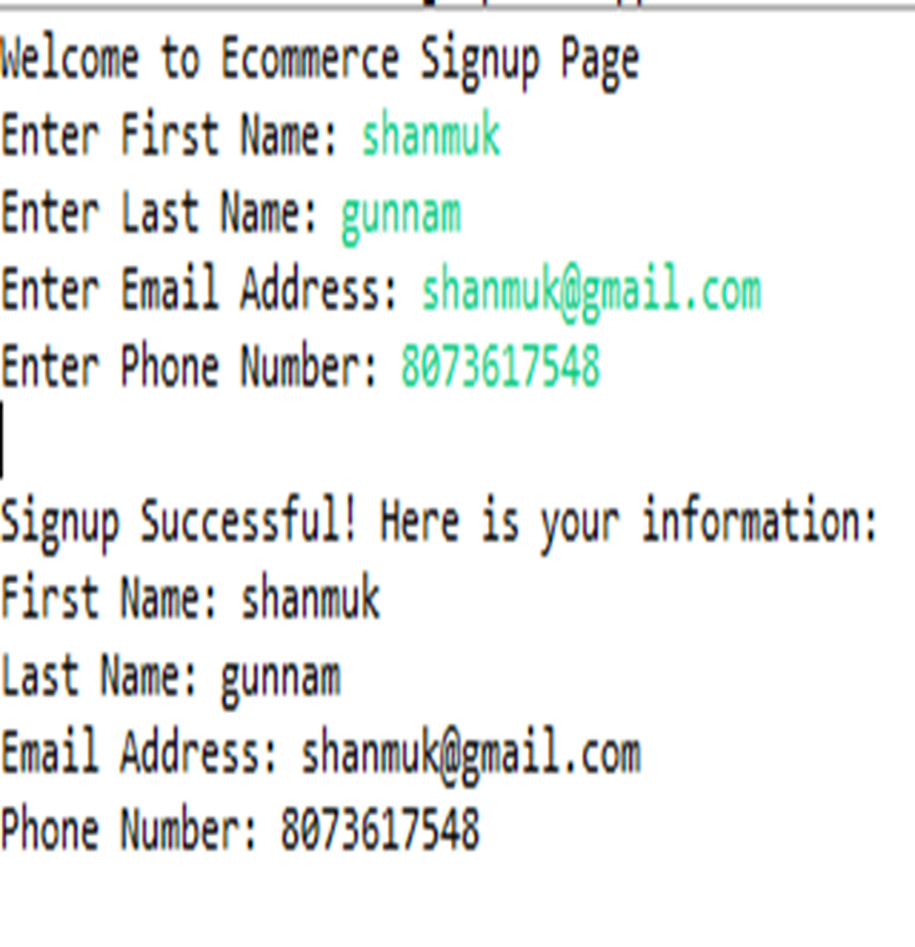
Input& Output

Slide 11
Implementation using NodeJS
Node.js:
Read line module
Functions
Validations
Promises
Asynchronous
Reg Ex

Slide 12
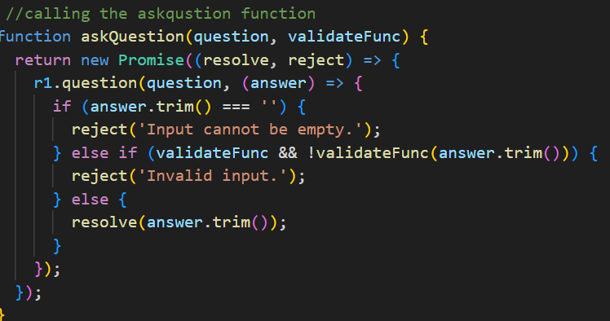
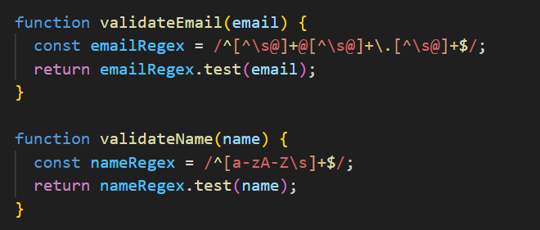
Logic
Promise:
Validations:

Slide 13
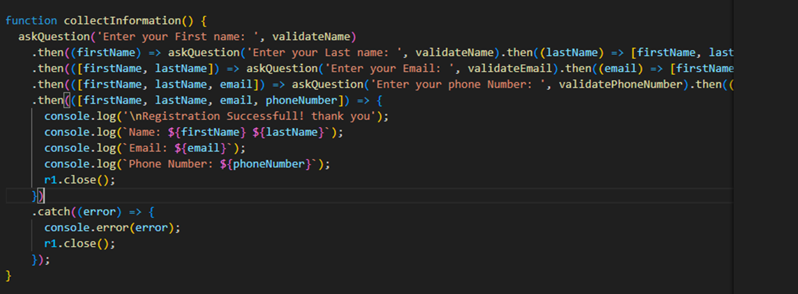
Logic
Async function:

Slide 14
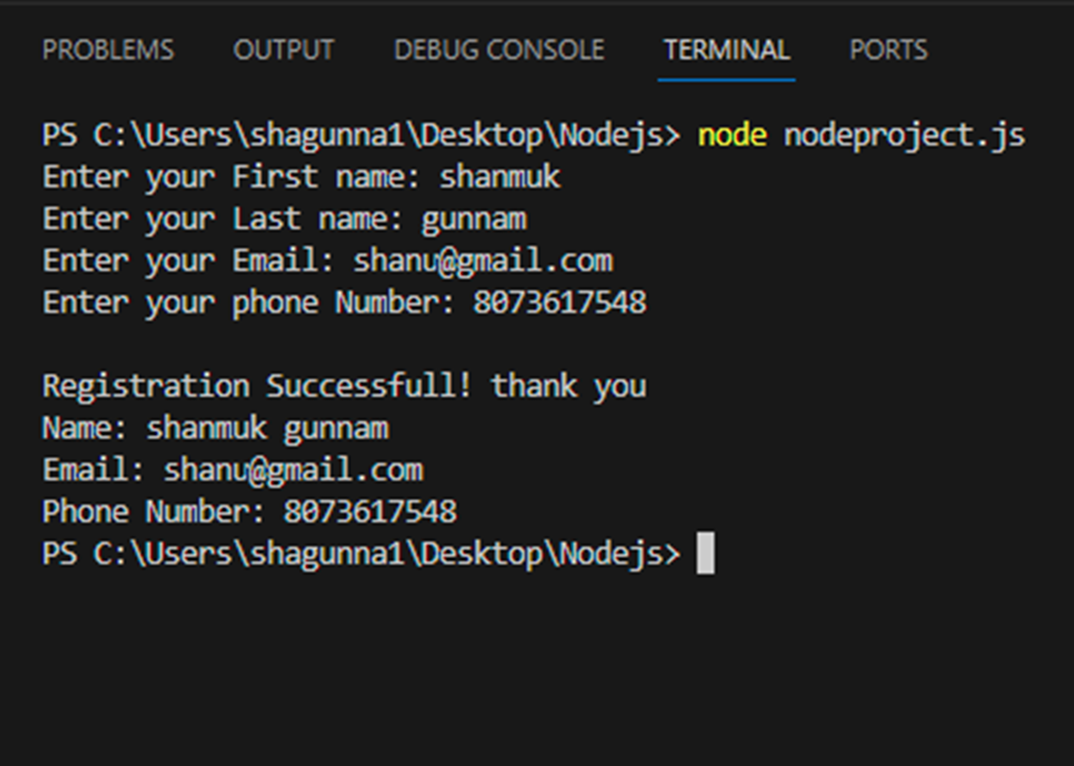
Input& Output

Slide 15
Connecting to Data Base
Node.js:
Read line module
Functions
Validations
Promises
Synchronous and asynchronous
MongoDB

Slide 16
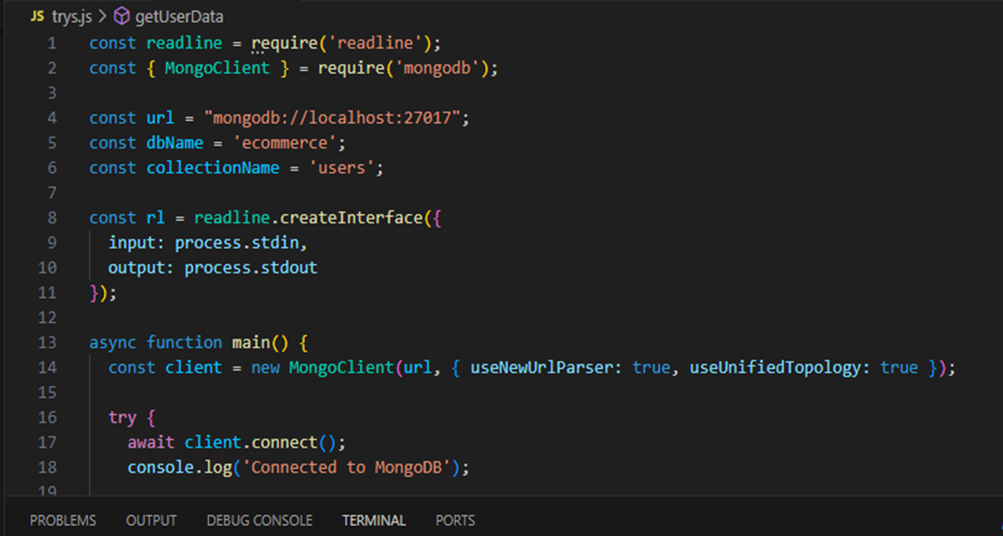
Logic
Connecting to MongoDB:

Slide 17
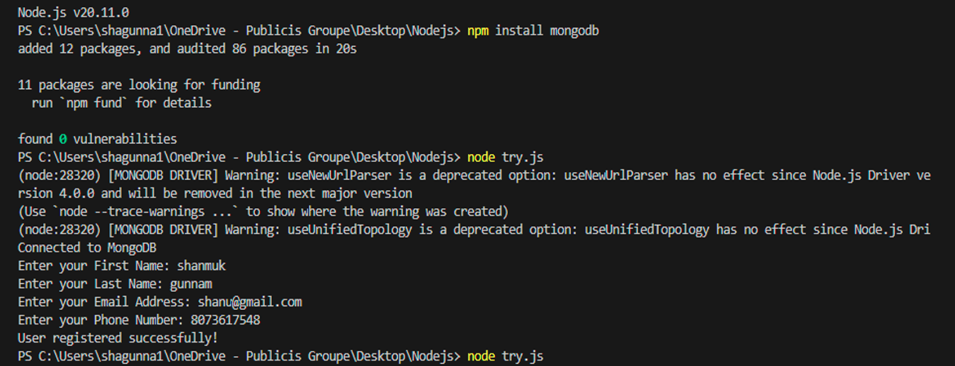
Input

Slide 18
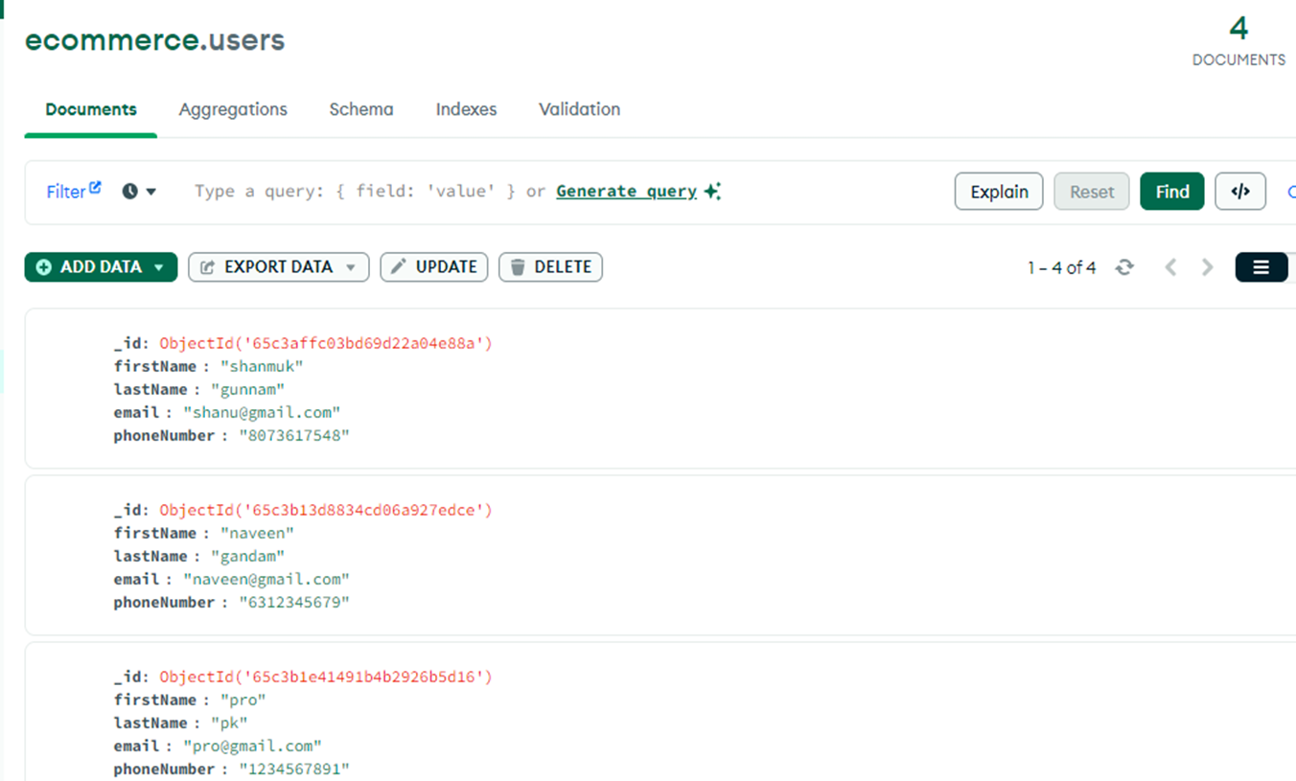
Output

Slide 19
Test Cases
Action | Expectations
Verification of First name | First Name should contain only characters no numeric values should be included.
Verification of Last name | Last Name should contain only characters no numeric values should be included
Verification of Email | Email should contain “@” its mandatory
Verification of phone.no | Mobile should contain only numeric values and contain 10 digits.

Slide 20
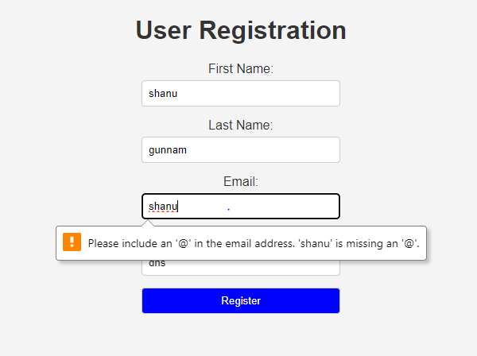
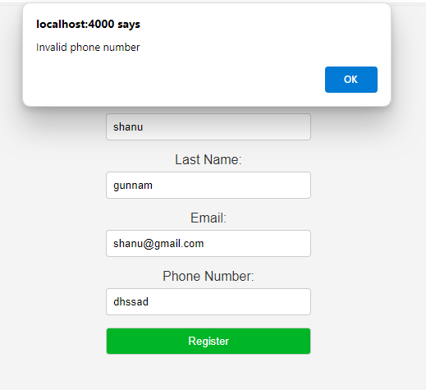
Testing

Slide 21
Functional & Non-functional test cases
Functional test cases | Non - functional test cases
User input validations | Performance
Invalid Email Address | Useability
Empty Input | Security
Invalid phone.no | Error Handling
Valid Signup | Compatibility

Slide 22
JIRA
Ecommerce Signup Page
Project Planning
Develop simple console based application
Develop in JAVA
Convert into NodeJS and connect to server
Connect to database

